Slide 1

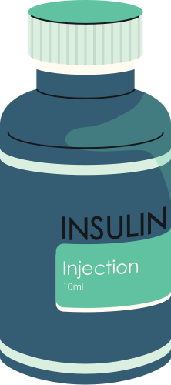
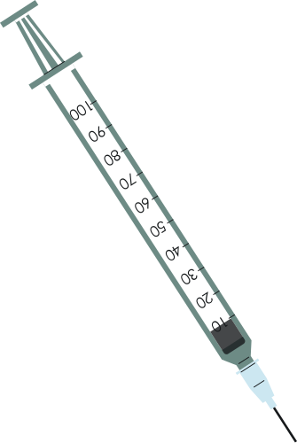




MedTrove
Development
Aliza Ibrahim 21i-0470
Kissa Zahra 21i-0572
Hamna Sadia Rizwan 21i-0603
Supervisor: Mr. Bilal Khalid Dar
Co-Supervisor: Ms. Zoya Mahboob

Slide 2









Overview
Functional Requirements
Problem Statement
Problem Solution
Artifacts
Non - functional Requirements
FYP Poster
Timeline
Workdivision

Slide 3


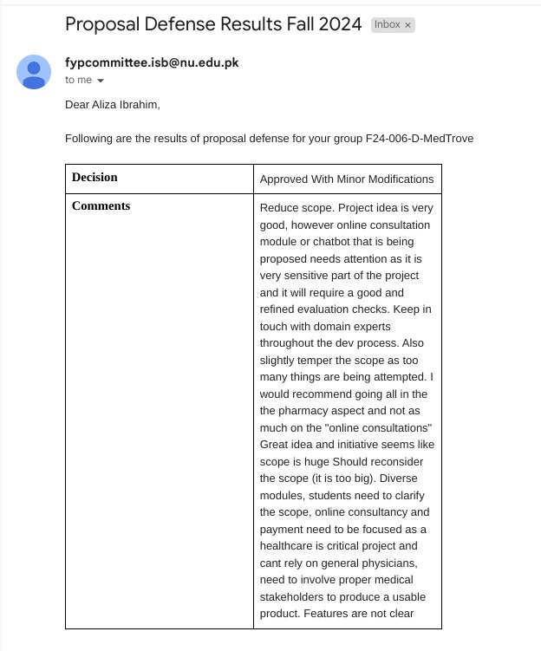
Comment
1

Slide 4

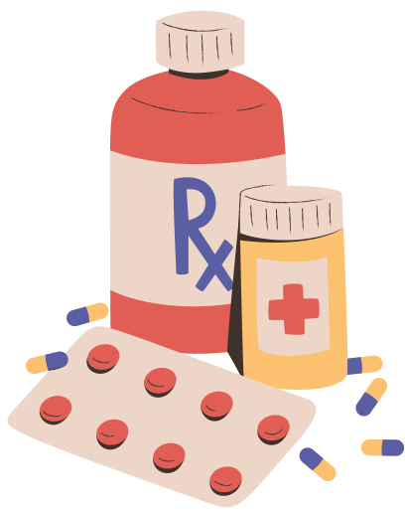

Problem Statement
Medication prices surged by up to 200% since 2019.
High prevalence of diabetes (26.7%) and heart diseases (29% of deaths).
Corruption in healthcare exacerbates affordability issues.
40% of Pakistanis live below the poverty line as of 2024.
2

Slide 5

Problem Solution
MedTrove Mobile Application:
Search + Alternatives
Medibot
Online Doctor Consultations
3

Slide 6

Non - Functional Requirements
Performance
Usability
Reliability
4

Slide 7

Functional Requirements
(Module) Substitute Drug Identifier
(Module) Search and Recommendation
(Module) Profile Management
5

Slide 8
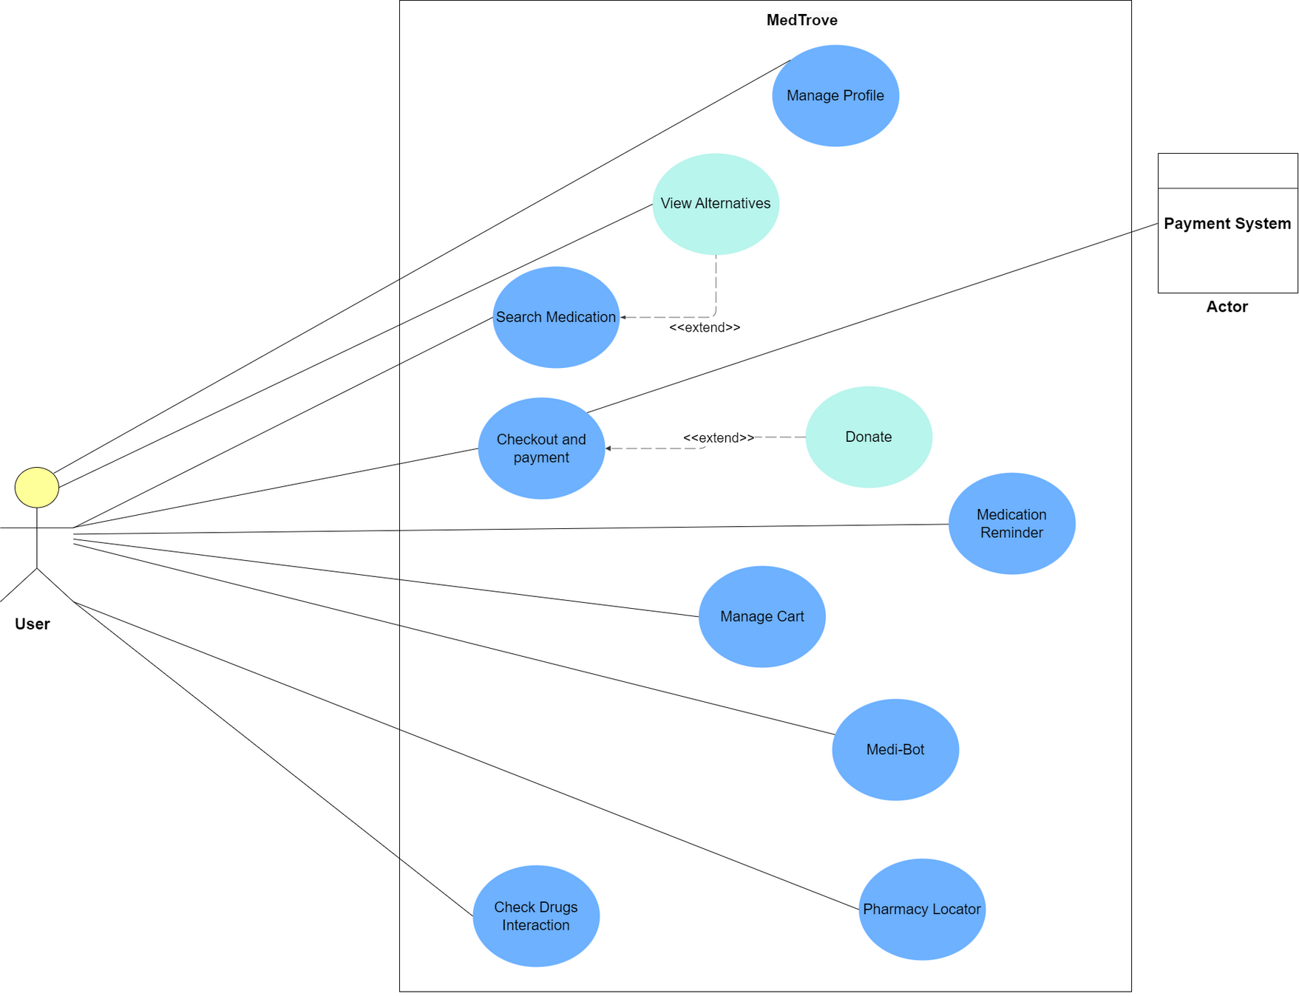

U
S
E
C
A
S
E
6

Slide 9
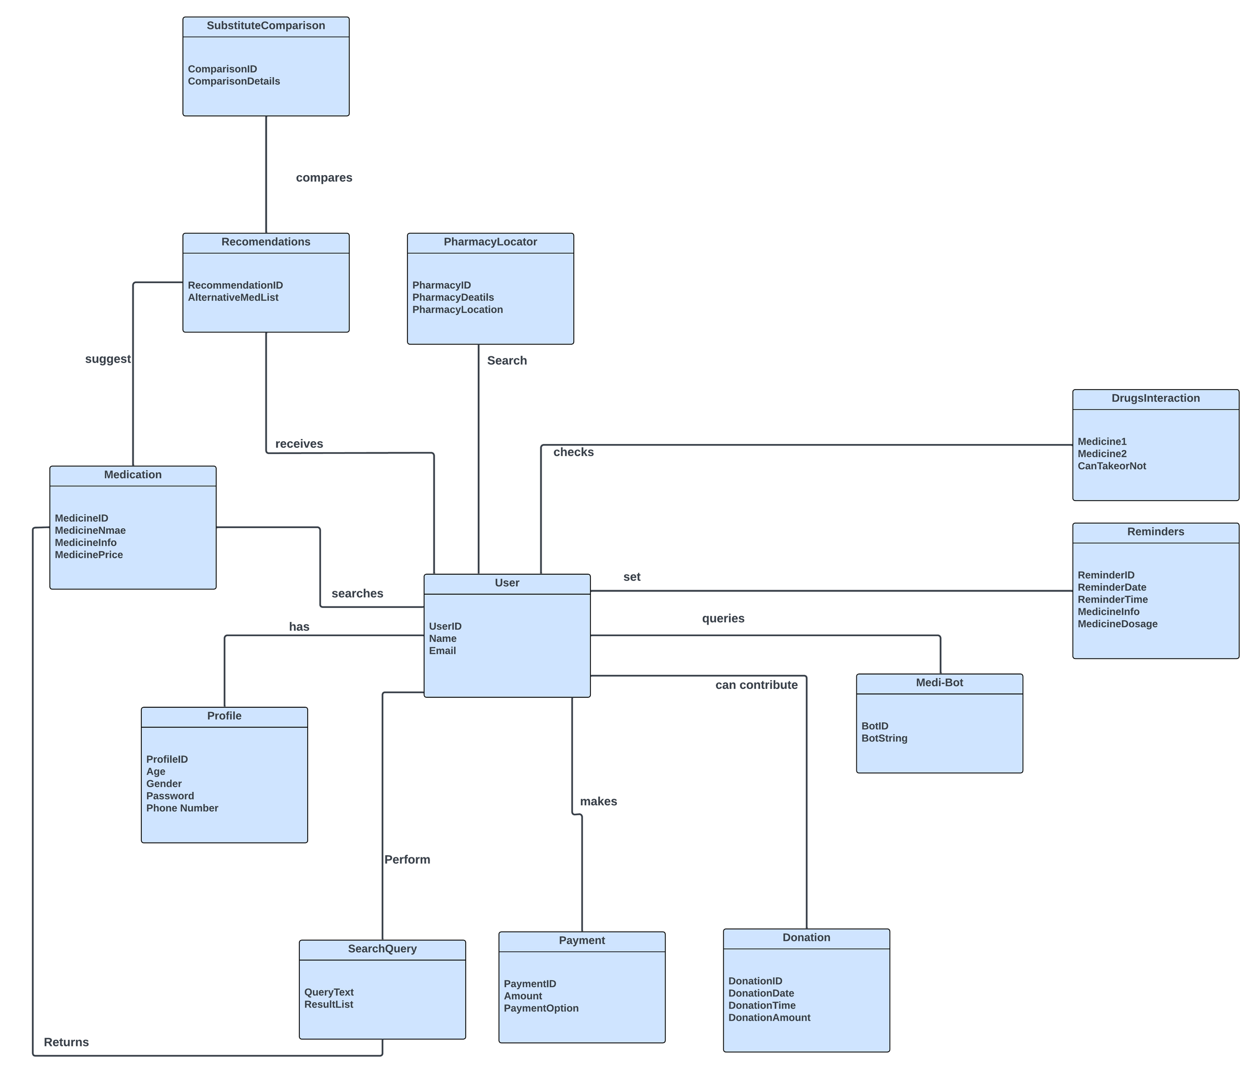
D
O
M
A
I
N
M
O
D
E
L
7

Slide 10
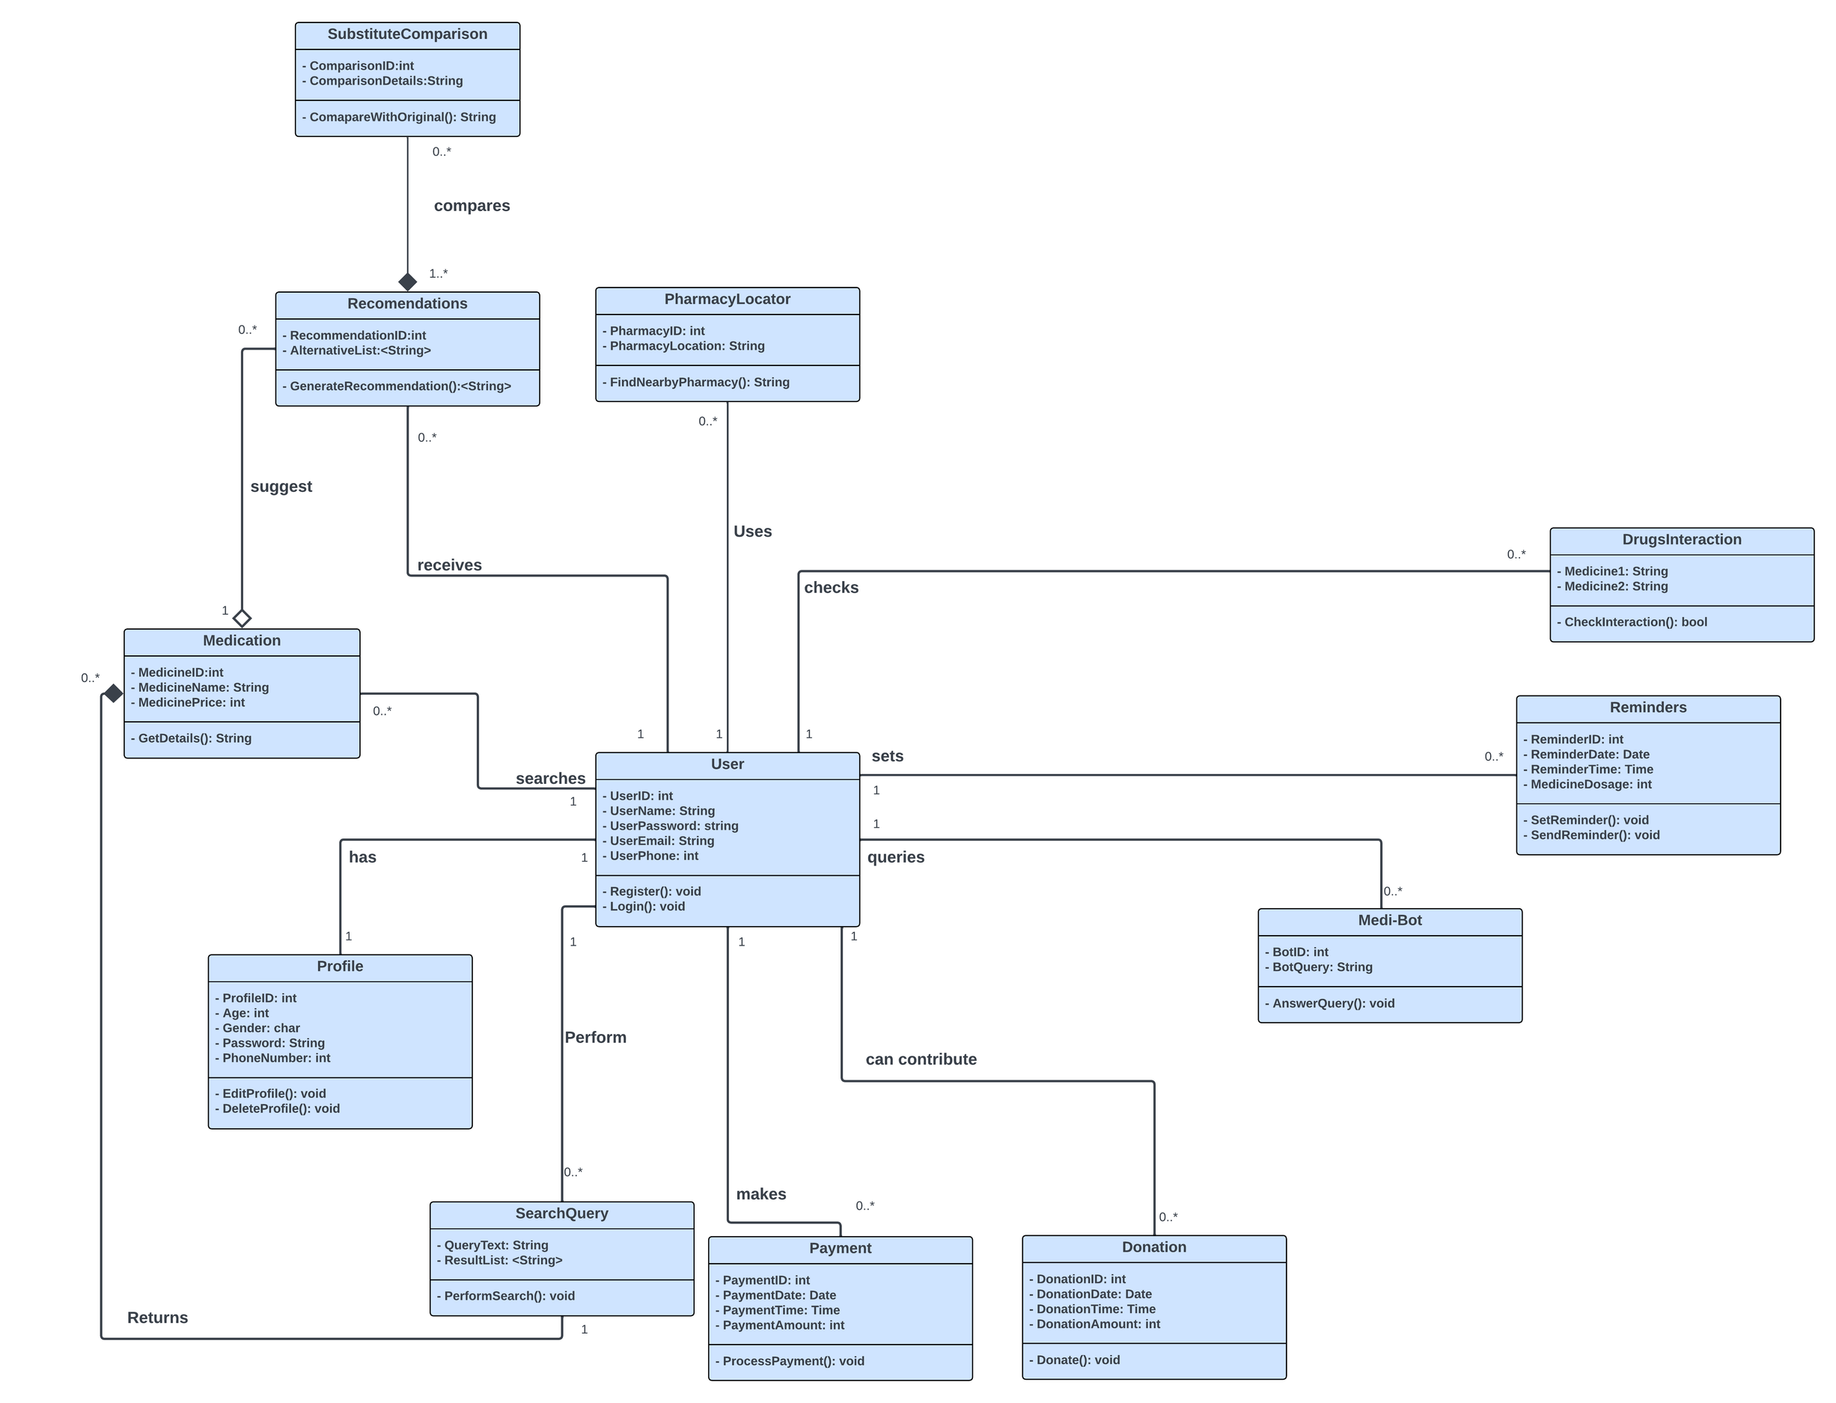
C
L
A
S
S
D
I
A
G
R
A
M
8

Slide 11
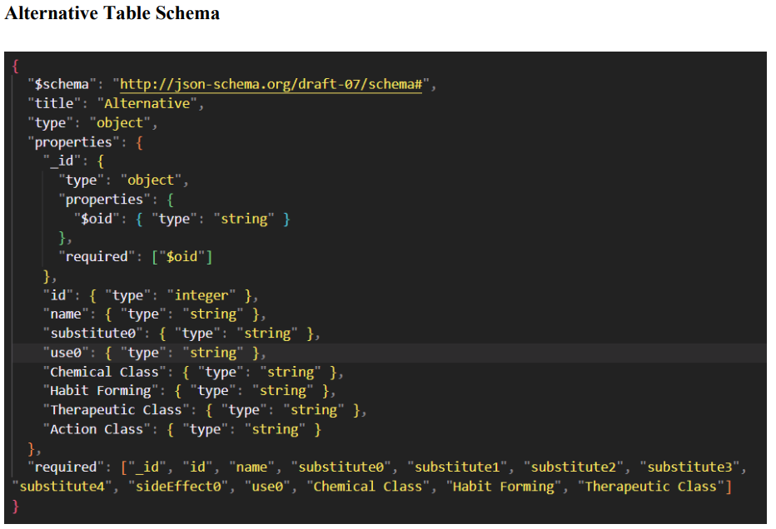
S C H E M A
9

Slide 12
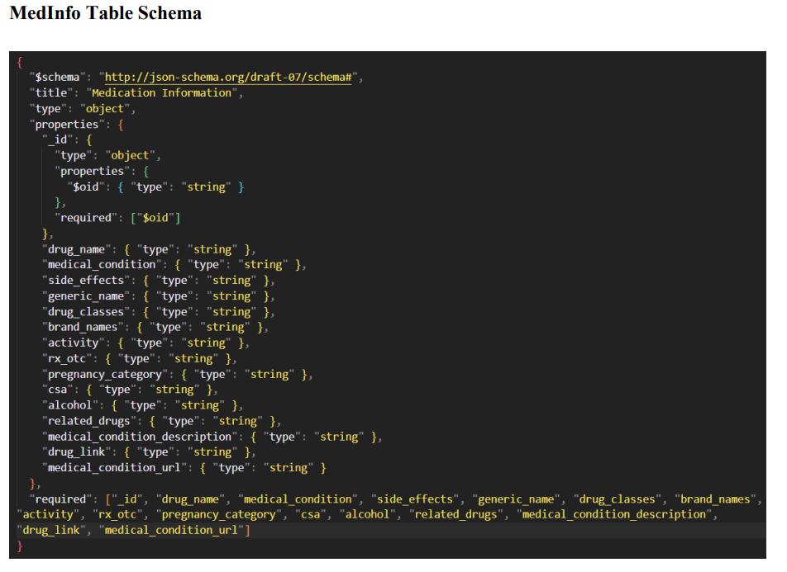
S C H E M A
10

Slide 13
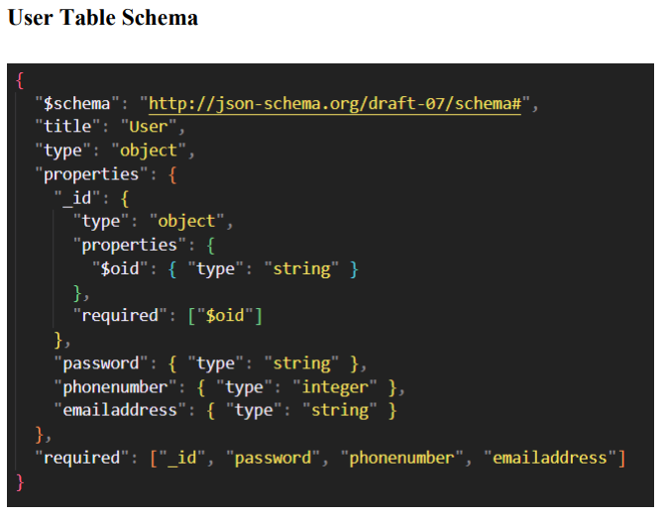
S C H E M A
11

Slide 14
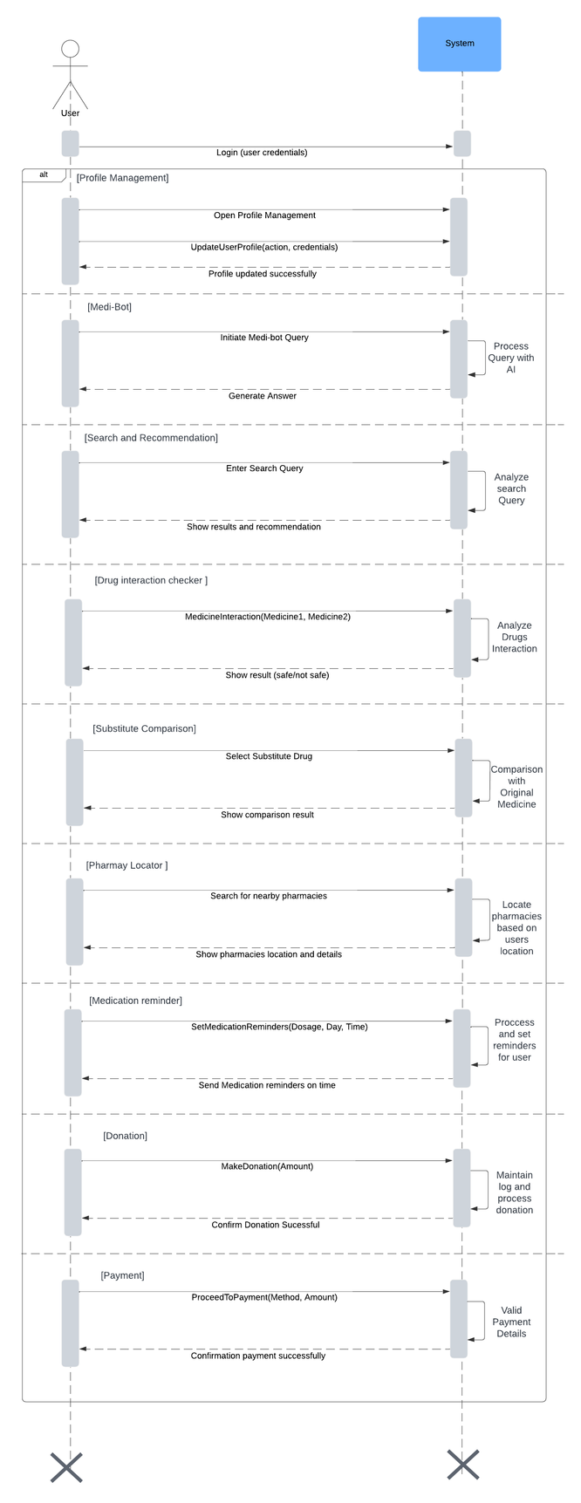
S
S
D
12

Slide 15
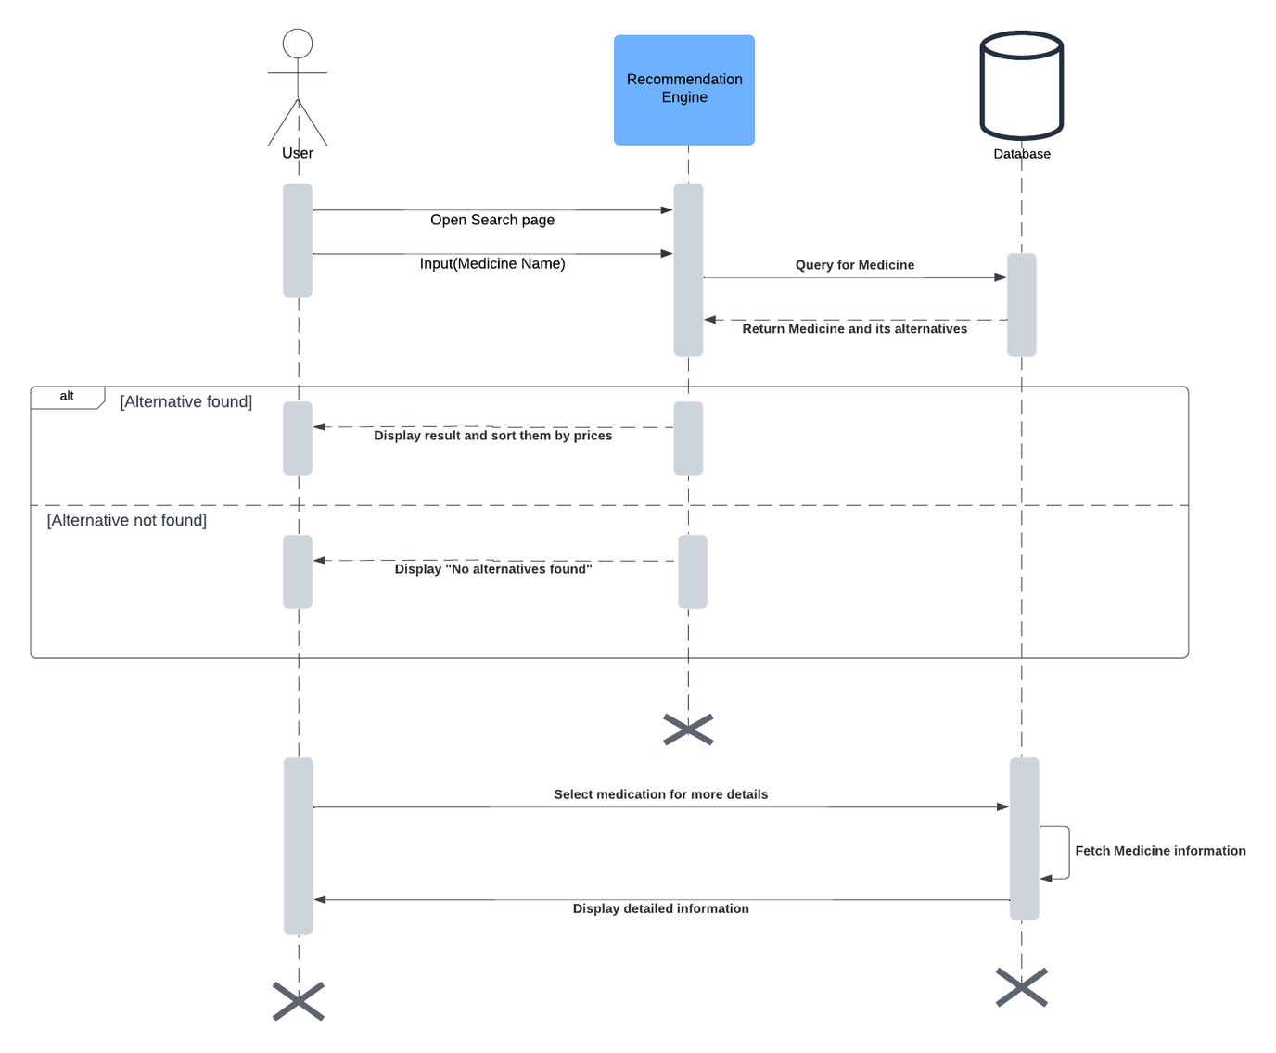
Search and Recommendation
S
D
13

Slide 16
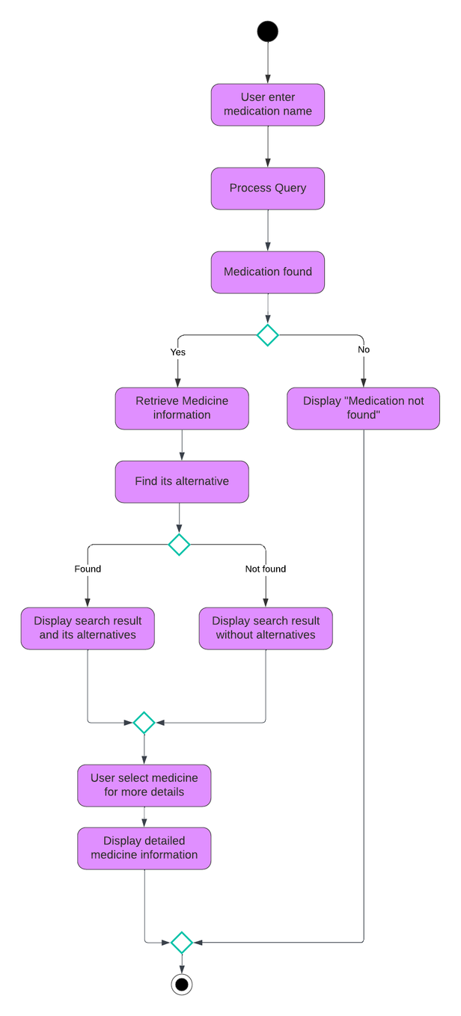
Search and
Recommendation
A
C
T
I
V
I
T
Y
14

Slide 17
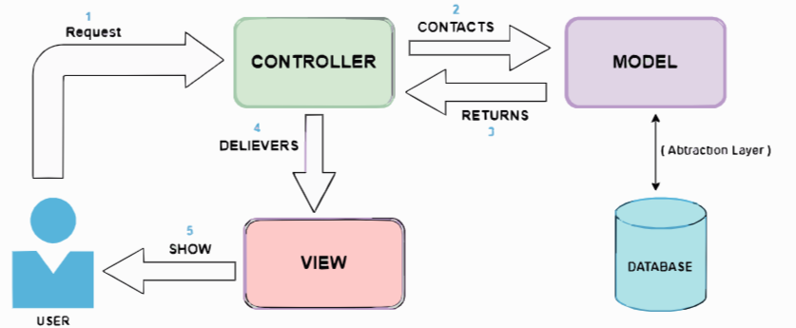
Architecture Diagram
15

Slide 18
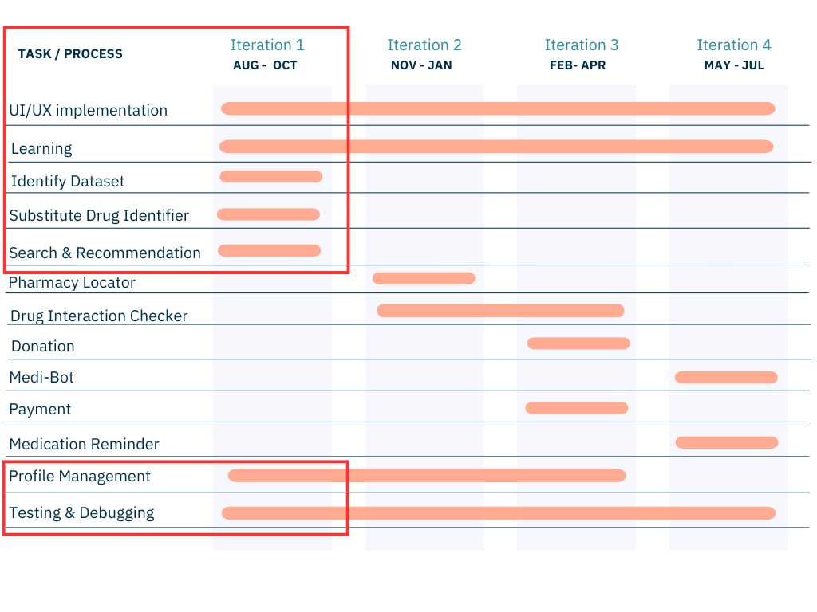
T
I
M
E
L
I
N
E
16

Slide 19

Iteration & work Breakdown
Iteration Task | Status | Done By
UI/UX |  | Hamna, Aliza
Identify Dataset |  | Hamna,Kissa & Aliza
Substitute Drug Identifier |  | Hamna
Search & Recommendation |  | Aliza, Kissa
Profile Management |  | Kissa
Testing & Debugging |  | Kissa, Aliza & Hamna
Documentation |  | Kissa, Aliza & Hamna
17

Slide 20
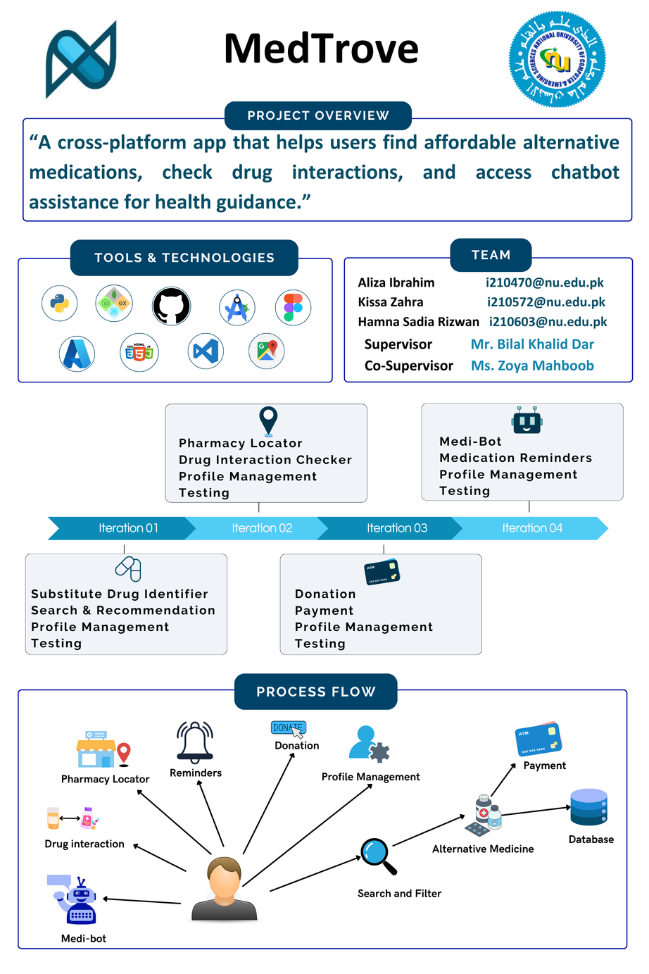
MedTrove Poster
18

Slide 21

Conclusion
19

Slide 22

References
[1] F. Durrani, “Increase in drug prices highest in last 40 years,” 8 April 2019. [Online]. Available: https://www.thenews.com.pk/print/454864-increase-in-drug-prices-highest-in-last-40-years. [Accessed 12 July 2024].
[2] “Govt approves increase in prices of 146 essential life-saving medicines,” 1 February 2024. [Online]. Available: https://www.dawn.com/news/1810395. [Accessed 12 July 2024].
[3] “The increasing rate of diabetes in Pakistan: A silent killer,” [Online]. Available: https://www.ncbi.nlm.nih.gov/pmc/articles/PMC9289249/. [Accessed 12 July 2024].
[4] I. Junaidi and R. Zakaria, “'47 people die of heart attack every hour in Pakistan',” 30 September 2021. [Online]. Available: https://www.dawn.com/news/1649189. [Accessed 12 July 2024].
[5] “PAKISTAN: Implementing an Ambitious, Credible and Clearly Communicated Economic Reform Plan Critical for Robust Recovery, Poverty Reduction, says World Bank,” 2 April 2024. [Online]. Available: https://www.worldbank.org/en/news/press-release/2024/04/01/pakistan-implementing-an-ambitious-credible-and-clearly-communicated-economic-reform-plan-critical-for-robust-recovery-p. [Accessed 12 July 2024].
[6] Dawn, “Big Pharma and Physicians,” 6 October 2008. [Online]. Available: https://www.dawn.com/news/845158/big-pharma-and-physicians.

Slide 23


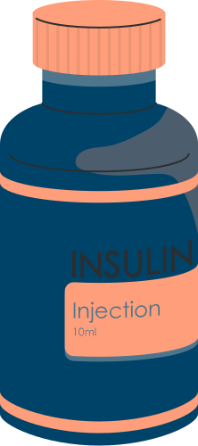
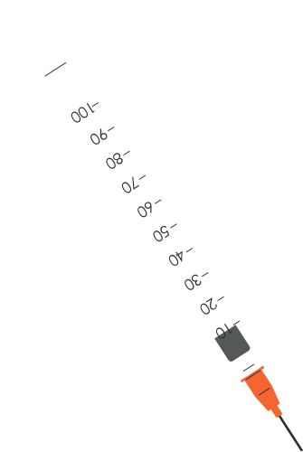

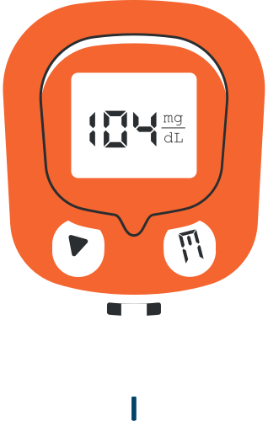
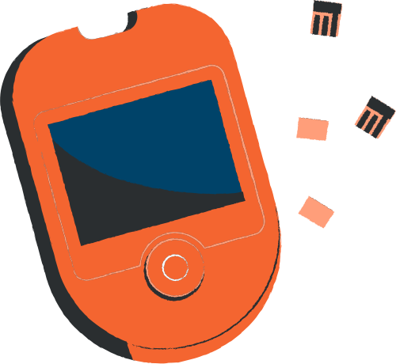
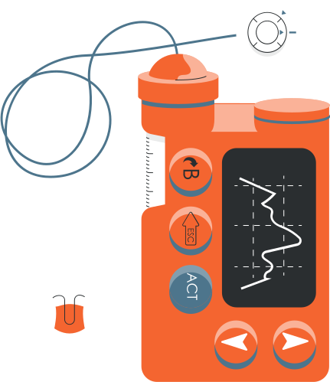

Thank You!
Any Questions?

